Slide 1
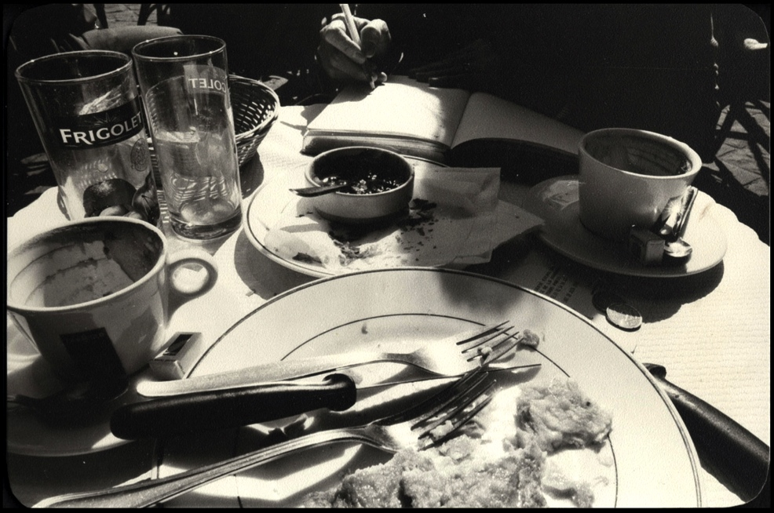
Writing to Learn
Jeff Goodman
Department of Curriculum and Instruction
Appalachian State University
goodmanjm@appstate.edu

Slide 2
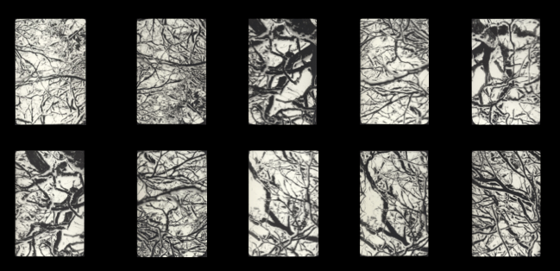
Lists
Ten reasons you write

Slide 3
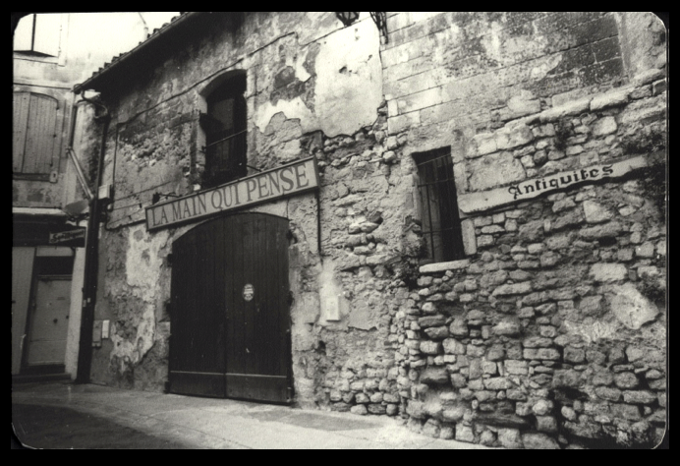
Writing for Thinking

Slide 4
Making connections

Slide 5
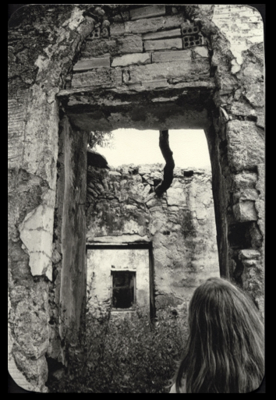
Retrieving memories

Slide 6
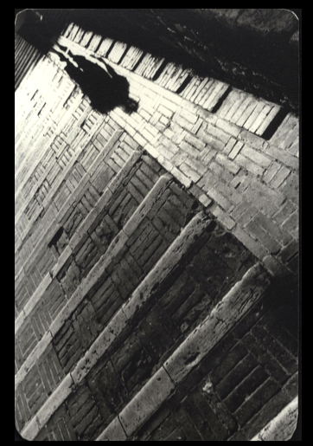
Examining evidence

Slide 7
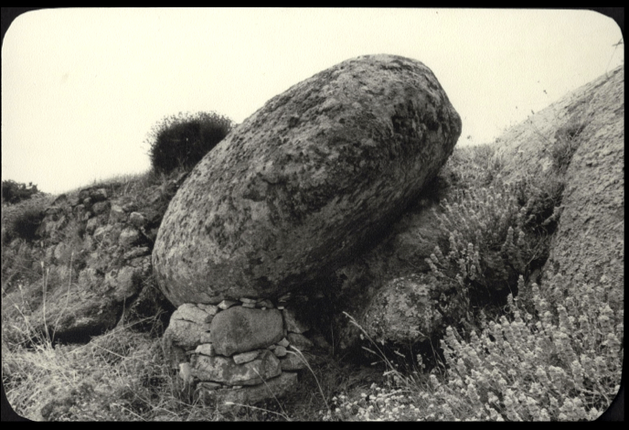
Slowing down

Slide 8
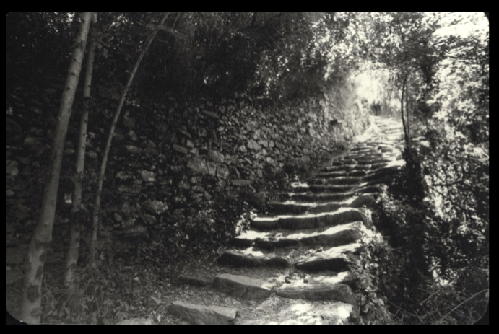
Creating a path down which you can go again

Slide 9
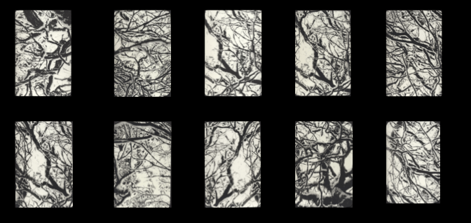
Types of writing

Slide 10
Writing to Learn vs. Learning to Write
Informal (low stakes) | Formal (high stakes)
Often short | Generally longer
Spontaneous | Planned
Informal | Formal
Exploratory | Authoritative
Personal | For and audience
Metacognition | Communication
Unedited/ one draft | Edited/ multiple drafts
Not graded | Formally assessed

Slide 11
Example lesson

Slide 12
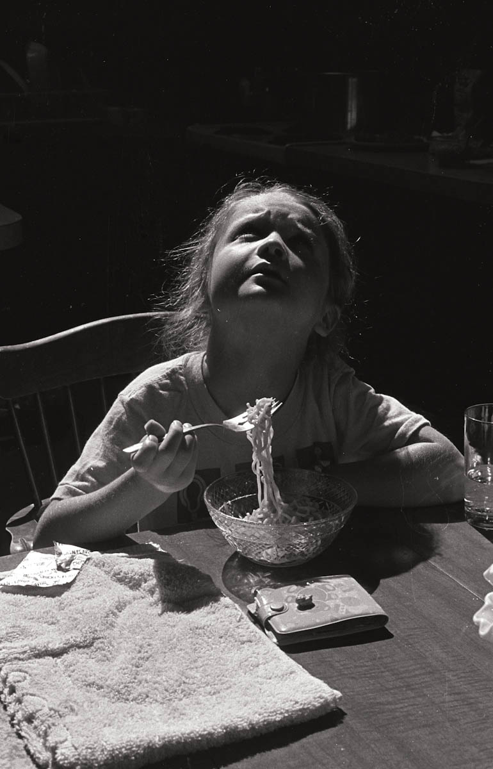
When did we use low-stakes writing during the lesson?

Slide 13
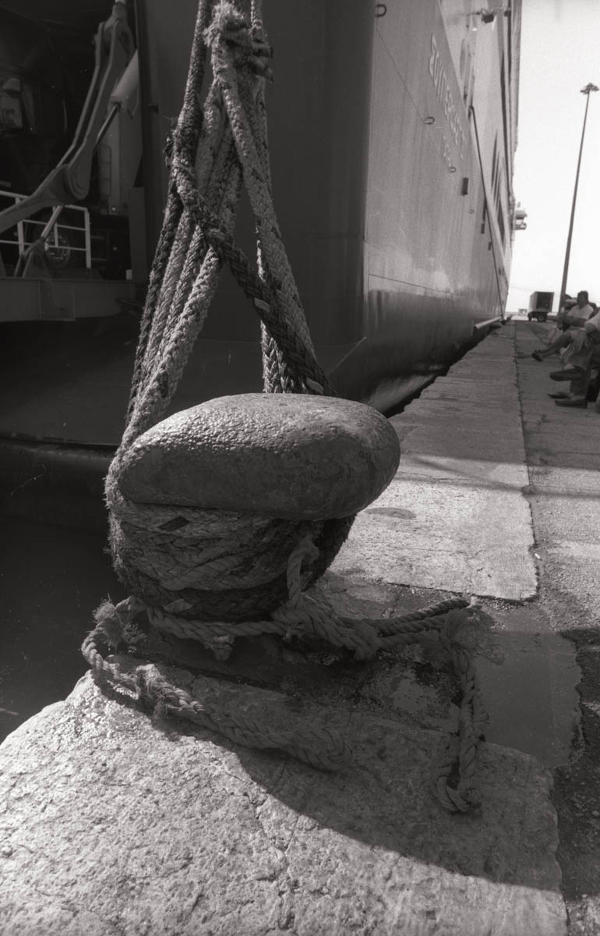
Before the lesson:
Activate prior knowledge
Contextualize instruction
Motivate attention

Slide 14
During the lesson
Slow everyone down to think
Incorporate metacognitive strategies
Make everyone process ideas personally

Slide 15
After the lesson
Synthesize ideas
Connect ideas to one another
Reflect

Slide 16
Other writing-to-learn techniques
Notes:
http://writing2.richmond.edu/wac/sprngbrd.html

Slide 17
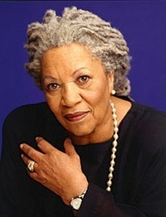
Sentence Springboard
Suddenly Nel stopped. Her eye twitched and burned a little. "Sula?" she whispered, gazing at the tops of trees. "Sula?" Leaves stirred; mud shifted; there was a smell of overripe green things. A soft ball of fur broke and scattered like dandelion spores in the breeze.
"All that time, all that time, I thought I was missing Jude." And the loss pressed down on her chest and came up into her throat. "We was girls together," she said as though explaining something. "Oh Lord, Sula," she cried, "girl, girl, girlgirlgirl.”
It was a fine cry—loud and long—but it had no bottom and it had no top, just circles and circles of sorrow.
Toni Morrison, Sula
Notes:
http://writing2.richmond.edu/wac/sprngbrd.html

Slide 18
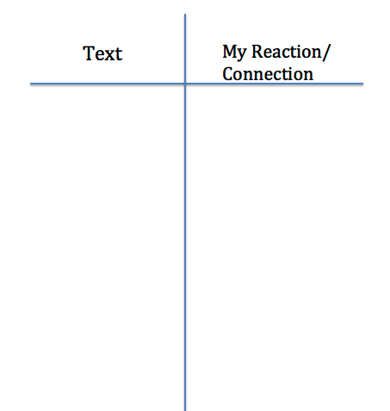
Double-entry Journal
Notes:
http://www.nytimes.com/2014/05/04/magazine/brother-can-you-spare-some-emphysema.html

Slide 19
Author’s prejudices/ my prejudices
Introduction to Poetry
By Billy Collins
I ask them to take a poem
and hold it up to the light
like a color slide
or press an ear against its hive.
I say drop a mouse into a poem
and watch him probe his way out,
or walk inside the poem’s room
and feel the walls for a light switch.
I want them to waterski
across the surface of a poem
waving at the author’s name on the shore.
But all they want to do
is tie the poem to a chair with rope
and torture a confession out of it.
They begin beating it with a hose
to find out what it really means.

Slide 20
One minute paper
What’s the most significant thing you have learned so far about writing-to-learn? Why is it significant to you?
Notes:
http://commons.wikimedia.org/wiki/File:Your_Job_is_Important%5E_-_NARA_-_534115.jpg

Slide 21
Assessing low-stakes writing
Check for completion
Randomly assess
Have students submit only some assignments
Collaborative writing after personal writing
Student self-assessment
Peer-review

Slide 22
What works
Focus on metacognition
Writing focus over an extended period in many curricula
Notes:
See: Bangert-Drowns, R. L., Hurley, M. M., & Wilkinson, B. (2004). The Effects of School-Based Writing-to-Learn Interventions on Academic Achievement: A Meta-Analysis. Review Of Educational Research, 74(1), 29-58.

Slide 23
Additional Benefits
Development of rapport with students
Identifying student misconceptions
Identifying students who have writing difficulties
Insight into the thinking of those who don’t speak up
Qualitative research shows students value it
Helps student practice collaboration and creative problem solving
Notes:
Fry, S., & Villagomez, A. (2012). Writing to Learn: Benefits and Limitations. College Teaching, 60(4), 170-175. doi:10.1080/87567555.2012.697081
Nevid, J. S., Pastva, A., & McClelland, N. (2012). Writing-to-Learn Assignments in Introductory Psychology: Is There a Learning Benefit?. Teaching Of Psychology, 39(4), 272-275. doi:10.1177/0098628312456622

Slide 24
Exit slips
Write: one way you can use writing-to-learn in your class right away.

